Slide 1
Overview | Colleague UI | WebAdvisor | Self Service | Informer
Colleague UI
What Colleague (formerly Datatel) Can Do for You!
Classified Development Day

Slide 2
Lesson Overview
Overview
Colleague Applications
Enterprise Applications System Map
How to Get Help
Requesting Access for Colleague
Colleague UI
Colleague Overview
Colleague User Guide / Demo
WebAdvisor
WebAdvisor Overview
Accessing WebAdvisor
Self Service
Self Service Overview
Logging into Self Service / Demo
User Profile
Self Service Icons
Informer
Informer Overview
Accessing Informer / Demo
Running Reports in Informer
Questions?
Learning objectives
Keywords
Standards
Topics

Slide 3
Colleague Applications
Colleague is the software used by entities within the Santa Clarita Community College District to manage and maintain data in support of academic and business practices. Data in Colleague is maintained through the use of the Colleague User Interface and is entered in real-time. This ensures that anyone accessing Colleague is presented with the most recent information. The information in Colleague is shared through WebAdvisor, Self Service, Informer, and other applications needing access to institutional information.
Colleague UI
WebAdvisor
Colleague UI (User Interface) is an Enterprise Resource Planning system used by COC to manage Student, Finance, and Human Resources data and other critical functions
Access to this system is controlled and requires granted security
Colleague’s old web solution that is being phased out in favor of Self Service
Lets students and employees access Colleague processes using a web browser. From anywhere.
Still used for Leave requests, some faculty functions, and authentication and tracking for outside services like transcripts and new student orientation
WebAdvisor support is ending June 30, 2022
Self Service
Informer
Ellucian’s new interactive robust web application that enables users to interact with their individual information in the Colleague databases
The successor to WebAdvisor
Lets students and employees access Colleague processes using a web browser. From anywhere.
Encompasses several modules that allow students to plan and register for classes (Student Planning), view their financial aid (Financial Aid), pay their tuition (Student Finance), and download 1098T tax forms (Tax Information)
Provides a way for faculty to perform Roster and Waitlist management functions (Faculty Overview)
Enables employees to change personal information such as address, phone number and email (User Profile)
Informer delivers business intelligence and data analysis solutions for College of the Canyons
Faculty and staff can run reports using Informer based off of data in Colleague
Informer is also used by Enterprise Applications to generate State and Federal Reporting
???
In March 2012, Datatel merged with SunGard Higher Education to form Ellucian. The name of the application changed to “Colleague”.

Slide 4
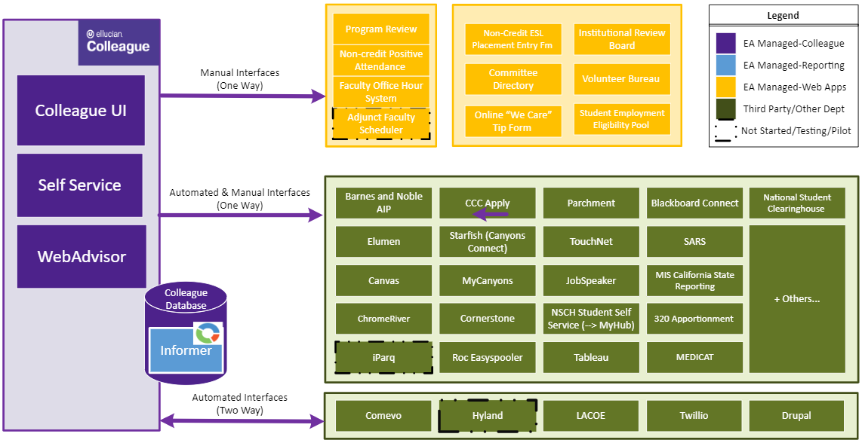
Enterprise Applications System Map

Slide 5
How to Create a Ticket
How to Request Access to Colleague
How to Get Help
Call Computer Support/Help Desk at X3953 or 661-362-3953
Email helpdesk@Canyons.edu
Zoom: https://intranet.canyons.edu/departments/it/ - You will need to login to the Intranet to access support.
Please Provide the Following Information:
Screen name where error is occurring
Student ID #, Requisition #, etc.
What does error say
Screen Shot (Snipping or Snag It Tool)
You will receive a Ticket # to keep track of your case
*Note hours of support are below:
Monday-Thursday 7:00am – 9:00am
Friday 7:00am – 5:30pm
Standards

Slide 6
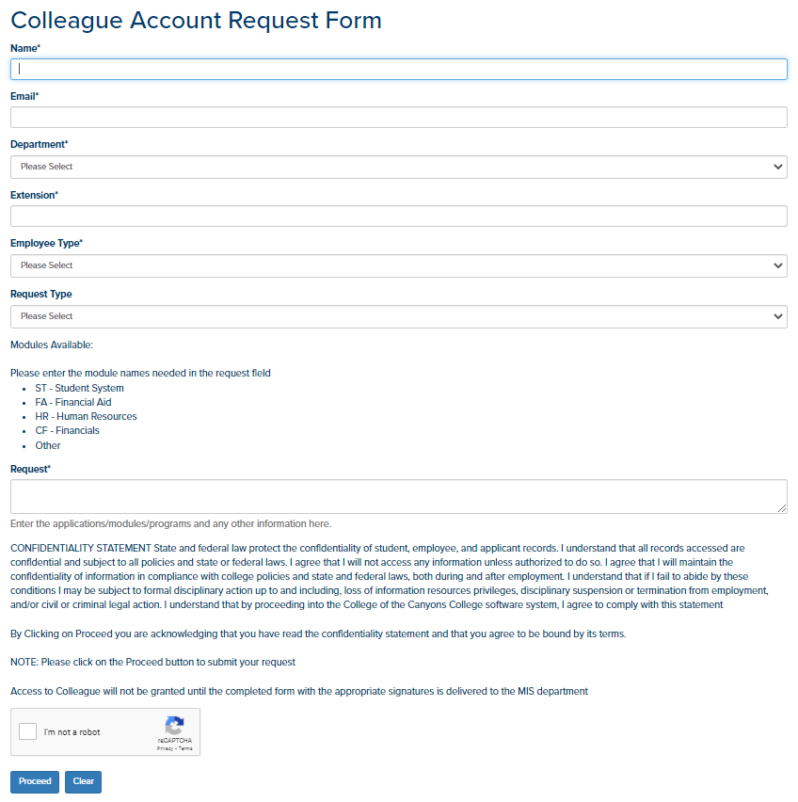
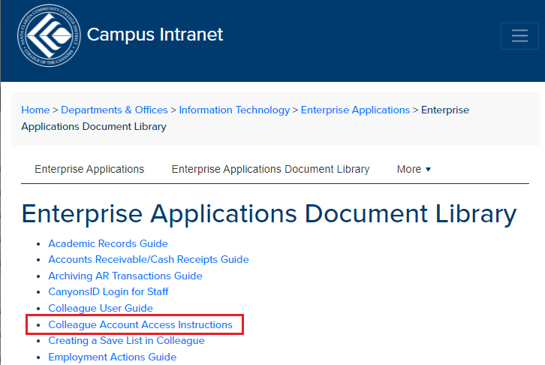
How to Request Access to Colleague
To access the Colleague Account Request Form directly:
https://intranet.canyons.edu/departments/it/applications/accountrequest.php
Requesting Access for Colleague
Instructions to request access to Colleague are in the link below. Click on Colleague Account Access Instructions:
https://intranet.canyons.edu/departments/it/applications/docs.php
(You will need to login to the Intranet to access the Document Library)
Standards

Slide 7
Colleague UI Overview
Academic Records
Admissions Management
Accounts Receivable
Communications Management
Cash Receipts
Curriculum Management
Demographics
Faculty Information
Custom ST Screens
…
Integrated system that connects COC data and processes
Comprehensive view of students, finances, human resources, and other critical business functions
Colleague UI
Budget Management
General Ledger
Purchasing
Financial Information
Custom CF Programs
…
CF
Finance
ST
Student
Core
HR Human Resources
Person Demographics
Communications Management
Scheduling
…
Utilities
Human Resources
Utility Master Menu
Custom Leave Reports
…
Demo: Colleague UI Navigation
System Administration
System File Administration
System User
Workflow Management System
…

Slide 8
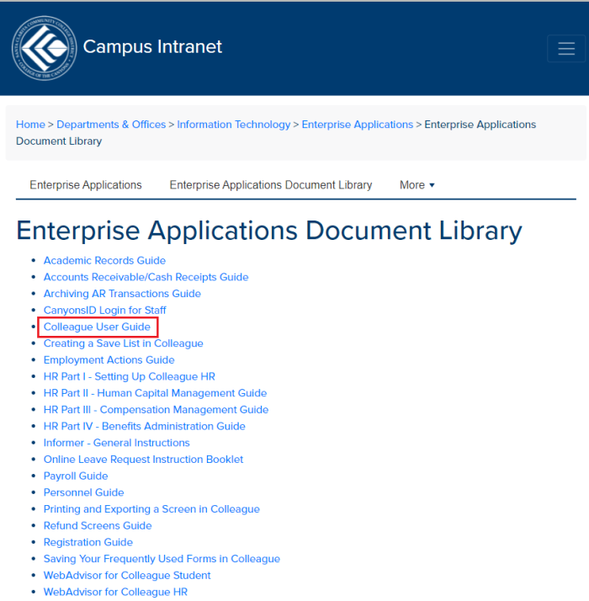
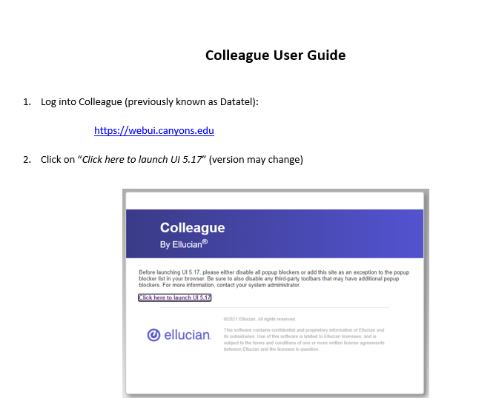
Colleague UI User Guide
The link to get access to the Colleague User Guide is:
https://intranet.canyons.edu/departments/it/applications/docs.php
(You will need to login to the Intranet to access the Document Library)

Slide 9
WebAdvisor Overview
WebAdvisor Retirement
Support ending June 30, 2022
Functions transitioning to Self Service or alternative solutions
What’s Left in WebAdvisor?
Leave Requests & Reporting Grading Drop Students from Roster Attendance Adjunct Contracts Enrollment Verification | Official Transcripts New Student Orientation PAL Orientation Online Refund Request 1098T Opt-In Financial Agreements

Slide 10
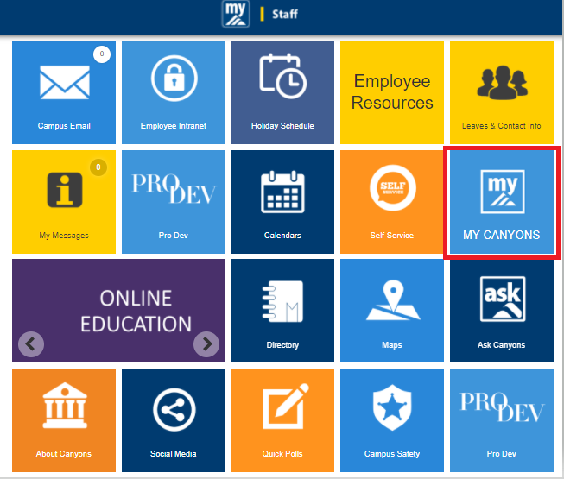
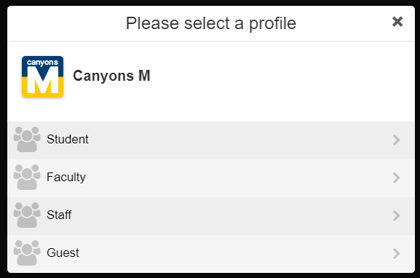
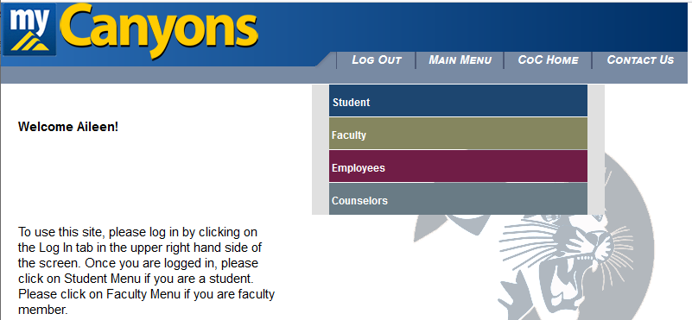
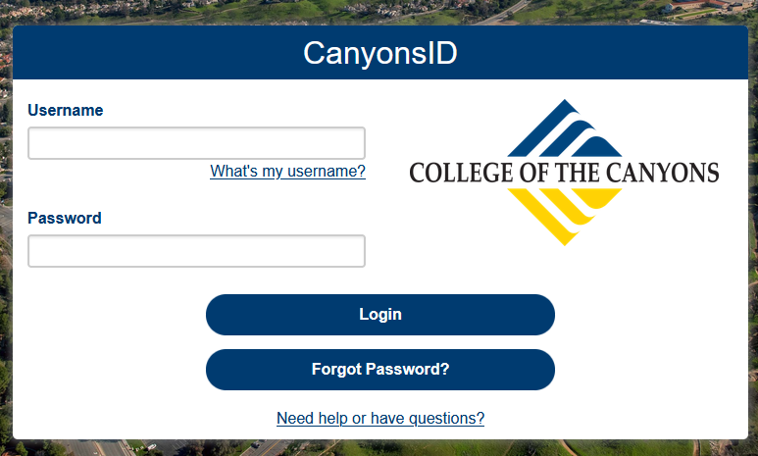
Accessing WebAdvisor
Two ways to login into WebAdvisor:
1. Log into the New MyCanyons:
https://m.canyons.edu/campusm/home#select-profile
Select your profile (Student, Faculty, Staff, Guest)
Follow instructions below on logging into CanyonsID
Click on the MY CANYONS tile
2. Direct URL - https://wa.canyons.edu/WebAdvisor/WebAdvisor
Click on LOG IN
Follow instructions below on logging into CanyonsID
You will be directed into the CanyonsID login screen.
Log into CanyonsID using your username and password.
Username: staff\lastname_first initial (e.g. staff\jagger_m)
Password: <this is the same as your network password>

Slide 11
Self Service Overview
Web application enables users to interact with information in the Colleague databases
Successor to WebAdvisor
Payment
Billing / Account Activity
1098T
Helpful Links
Course Management
Rosters
Waitlist
Add Authorizations
Self Service
What’s Moving to Self Service from WebAdvisor?
Student Finance
Faculty
Leave Requests and Reporting Grading Drop Students from Roster Attendance Refund Request 1098T Opt-In Financial Agreements
Financial Aid Status
Financial Aid Forms
Helpful Links
Financial Aid
Student
User Profile
Course Catalog
Class Schedule
Plan, Register, Waitlist and Drop Classes
Registration Time
Registration Holds
Unofficial Transcripts
Academic Planning
View and change Addresses, personal Email, and Phone Numbers

Slide 12
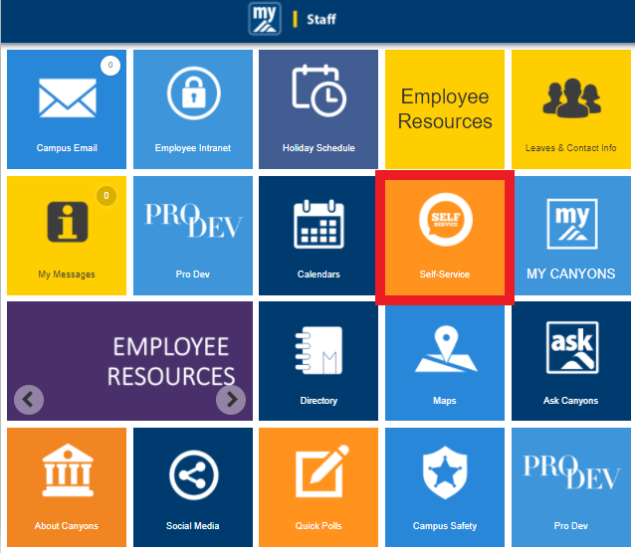
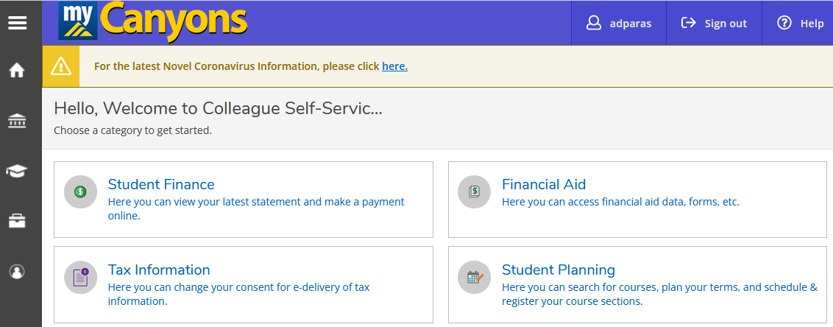
Logging into Self Service
Two ways to login into Self Service:
Log into the New MyCanyons:
https://m.canyons.edu/campusm/home#select-profile
Select your profile (Student, Faculty, Staff, Guest)
2. Direct URL - https://selfservice.canyons.edu/Student/Account/Login
What’s Moving to Self Service
You will be directed into the CanyonsID login screen.
Log into CanyonsID using your username and password.
Username: staff\lastname_first initial (e.g. staff\jagger_m)
Password: <this is the same as your network password>
Demo: Self Service Navigation

Slide 13
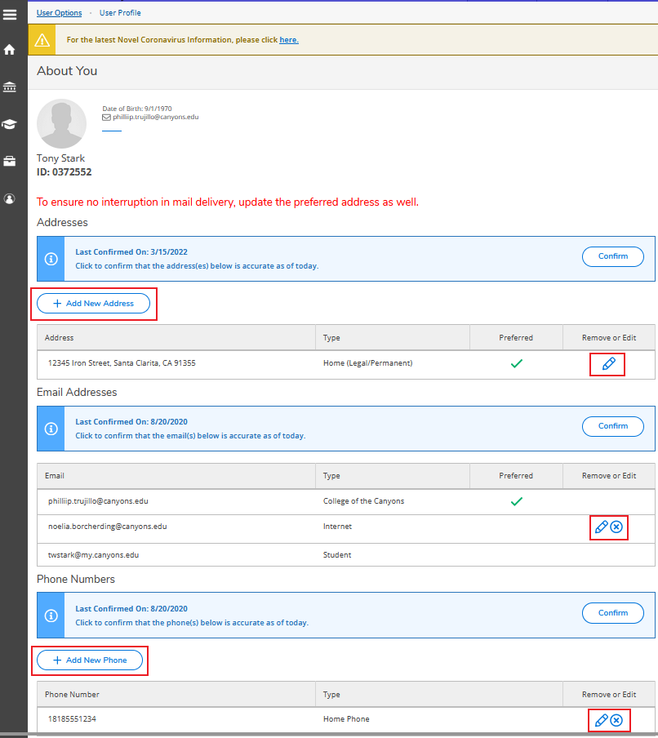
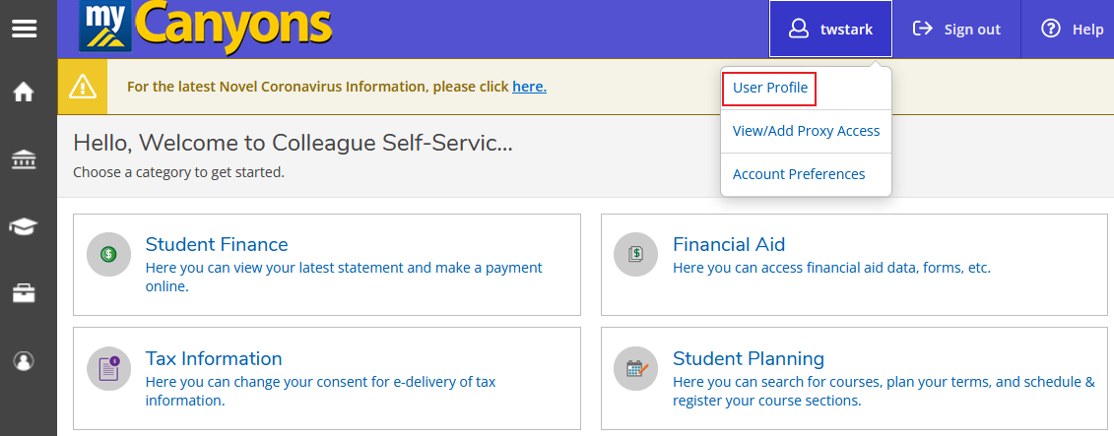
User Profile
To change your personal information, you will need to go to your User Profile in Self Service. You will be able to change your address, personal email (Internet), and phone number.
What’s Moving to Self Service

Slide 14
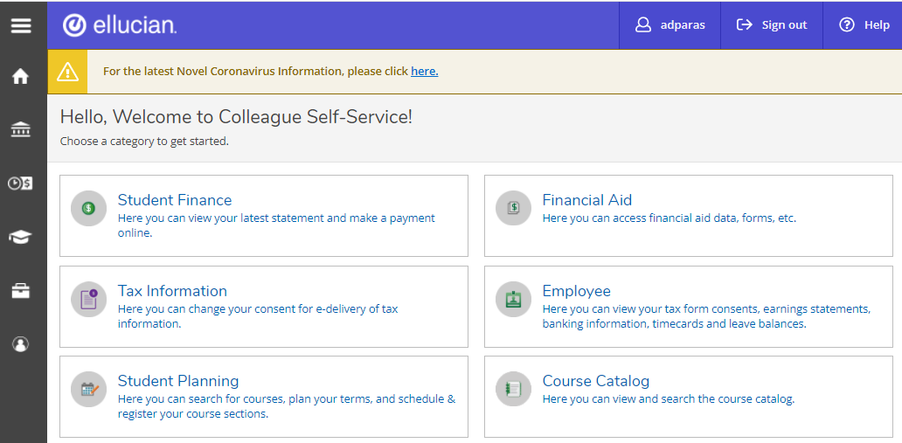
Self Service Icons
When you first login to Colleague Self Service, you most likely will see a screen similar to the one below. This is the “HOME” screen. Menus shown will be based on your security in the system and the features that have been turned on in Self Service.
Click on this to sign out of Self Service.
Click on this to expand the icons column.
Click on it again to shrink the column.
Click on this to display the Home page.
What’s Moving to Self Service
Click on this to display the Finance Information Menu.
Click on this to display the Employment Menu.
Click on this to display the Academics Menu.
Click on this to display the Daily Work Menu.
Click on this to display the User Options Menu.

Slide 15
Informer Overview
Informer is not an Ellucian Colleague application, but it uses the Colleague database!
Reporting solution to run reports using Colleague data
Used by Enterprise Applications to generate State and Federal reporting and COC support
Provides data for COC processes and third party applications
Staff
Faculty
Enterprise Applications

Slide 16
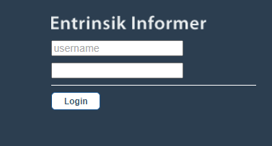
Accessing Informer
To access Informer, go to the link: https://informer.canyons.edu/informer/
Username: (user ID assigned to you)
Password: (Network login)
Click on Login
Demo: Informer Navigation

Slide 17
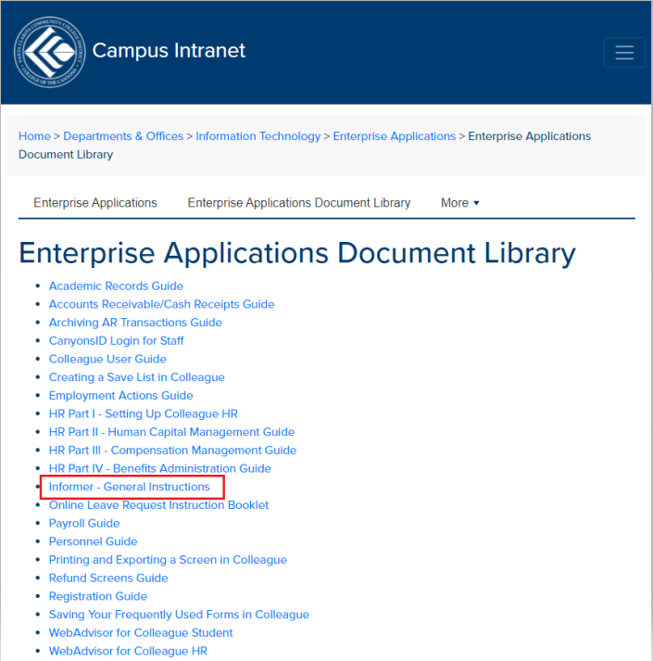
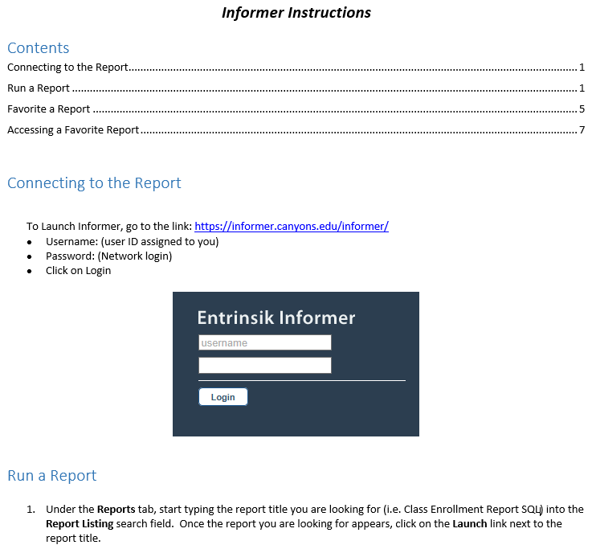
Running Reports in Informer
For instructions on using Informer, go to the below link and click on “Informer – General Instructions”:
https://intranet.canyons.edu/departments/it/applications/docs.php
(You will need to login to the Intranet to access the Document Library)

Slide 18
Overview | Colleague UI | WebAdvisor | Self Service | Informer
Colleague UI
Questions?
?

